Slide 1
Space Division Multiple Access
Mobile Satellite & Communication

Slide 2
Content
Introduction
Multiple Access Environment
Duplexing
Duplexing Types
Multiple Access Techniques
SDMA
Features of SDMA
Advantages of SDMA
Disadvantages of SDMA

Slide 3
Introduction
In wireless environment it is difficult to provide interference free environment.
Solution is to use multiple access techniques.
Multiple access techniques are used in :
Satellite network
Mobile communication
Acoustic networks
We will be focusing on wireless communication.

Slide 4
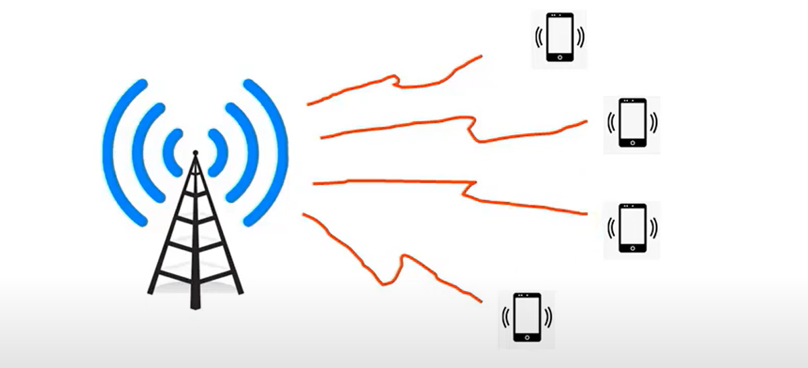
Multiple Access Environment
Credit : YouTube

Slide 5
Duplexing
Duplexing : simultaneous talk and listen.
For voice or data communications should be two way communication.
Duplexing done using frequency or time domain techniques.
Forward band (downlink) provides traffic from the Base Station to the mobile station.
Reverse band (uplink) provides traffic from the mobile station to the Base station.

Slide 6
Duplexing Types
Frequency Division Duplexing (FDD)
Forward band and reverse band are separated in frequency domain by assigning two different frequency.
Time Division Duplexing (TDD)
Forward band and reverse band takes place over same frequency but different instant of time but this time is too small to perceived by us.

Slide 7
Multiple Access Techniques
Multiple access schemes allow many mobile users to share a finite amount of radio spectrum in efficient manner.
Depending upon whether there exist any conflict or not among the various users we can classify multiple access techniques into two types:
Conflicting
Conflict free

Slide 8
Multiple Access Techniques
Conflict free Multiple access techniques can be implemented with the help of channelization.
Channelization techniques are:
Frequency division multiple access (FDMA)
Time division multiple access (TDMA)
Code division multiple access (CDMA)
Space division multiple access (SDMA)

Slide 9
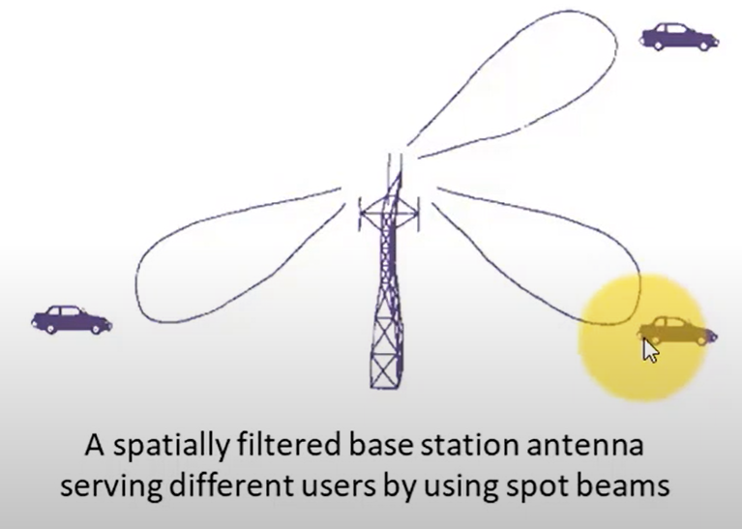
SDMA
SDMA stands for space division multiple access.
Depends on the user position information and provides users access to the communication channel based on their spatial locations.
Credit : YouTube

Slide 10
SDMA
SDMA serve different users by using spot beam antennas.
SDMA separates users on shared frequency by isolating them with directional antennas.
Most cell sites use three antennas to create 120° sectors that allow frequency sharing.
A single channel may be used simultaneously, if users are far from each other.

Slide 11
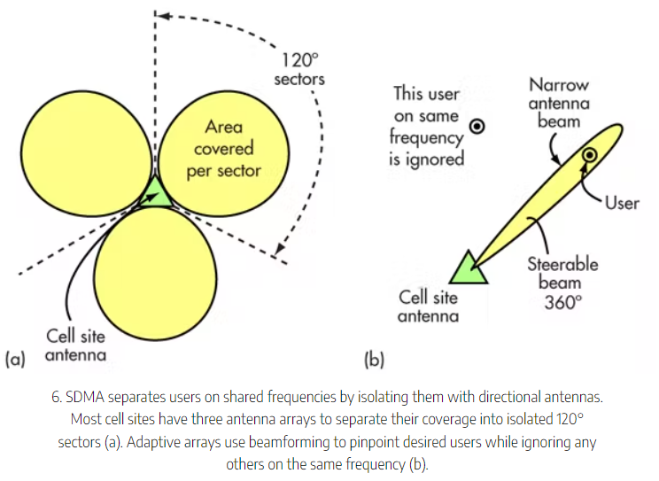
SDMA
Credit : electronicdesign.com

Slide 12
Features of SDMA
It is completely free from interference.
Can control the medium access for a wireless network.
Controlled radiated energy for each user in space.
All user can communicate at the same time using the same channel.
It can track the moving user.
It is never used in isolation.

Slide 13
Advantages of SDMA
Increases the capacity and speed of the system.
Increases transmission quality by focusing the signal into narrow transmission beams.
Free from interference.
All users can communicate at the same time using the same channel.
Two different signals can use the same frequency.
It minimizes system cost.
It increases the range.

Slide 14
Disadvantages of SDMA
Very expensive
Complicated to construct and design.
Perfect adaptive antenna system : infinitely large antenna needed.

Slide 15
Thankyou!

